Slide 1
2015-2016 Volunteer State Book Award Nominated Titles
Primary Division

Slide 2
Unspoken: A Story of the Underground Railroad by Henry Cole
In this wordless picture book, a young girl’s courage is tested when she discovers a runaway slave hiding in the barn. Should she help him? Or turn him in?

Slide 3
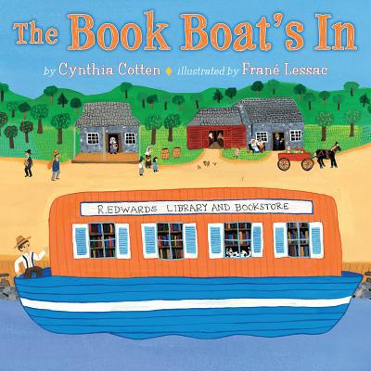
The Book Boat’s In by Cynthia Cotton; Illustrated by Frane Lessac
On a book boat on the Erie Canal in the 1800s, Jessie spots a used copy of The Swiss Family Robinson, then works very hard all week to earn the money he needs to buy it.

Slide 4
The Day the Crayons Quit by Drew Daywalt
Poor Duncan just wants to color. When he opens his box of crayons, he finds only letters written by his crayones. All of them seem to have issues. How can Duncan solve all of their problems?

Slide 5
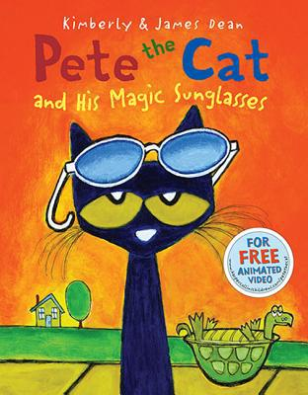
Pete the Cat and His Magic Sunglasses by James and Kimberly Dean
Pete the Cat wakes up feeling grumpy--nothing seems to be going his way. With the help of some magic sunglasses, Pete learns that a good mood has been inside him all along.

Slide 6
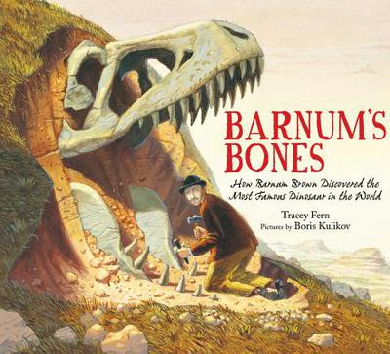
Barnum’s Bones: by Tracey Fern; Illustrated by Boris Kulikov
This biography describes how Barnum Brown discovered some of the famous dinosaur fossils ever found. He even uncovered the first fossil of a T. Rex.

Slide 7
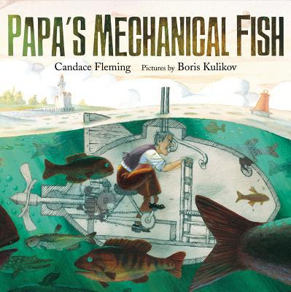
Papa’s Mechanical Fish by Candace Fleming; Illustrated by Boris Kulikov
Based on a true story, an inventor builds a fish-like submarine for his family during the 1850s.

Slide 8
Step Gently Out by Helen Frost; Photos by Rick Lieder
Poetry and photographs combine to give readers a glimpse into the world of insects.

Slide 9
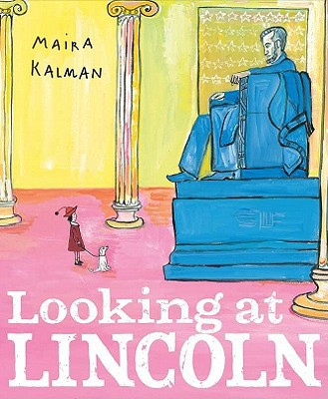
Looking at Lincoln by Maria Kalman
From his boyhood in a log cabin to his famous presidency and untimely death, Abraham Lincoln's remarkable life is revealed in a fresh and exciting way.

Slide 10
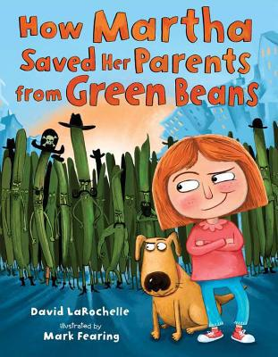
How Martha Saved Her Parents from Green Beans by David LaRochelle; Illustrations by Mark Fearing
Martha hates green beans. When a band of mean green beans invade her town and kidnap her parents, she has to take action.

Slide 11
The Invisible Boy by Trudy Ludwig; Illustrations by Patrice Barton
All of Brian’s classmates ignore him. It is as if he is invisible. When a new student arrives in class, Brian reaches out to him.

Slide 12
Tap the Magic Tree by Christie Matheson
This book encourages readers to interact with the story of a tree in different seasons.

Slide 13
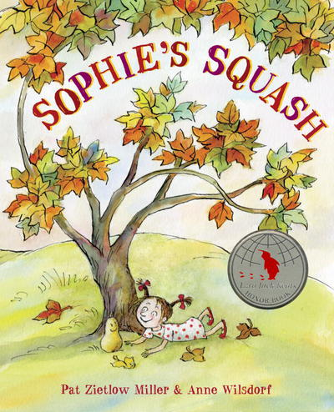
Sophie's Squash by Pat Zietlow Miller and Anne Wilsdorf
On a trip to the farmers' market with her parents, Sophie chooses a squash. Instead of letting her mom cook it, she names it Bernice. From then on, Sophie brings Bernice everywhere, despite her parents' gentle warnings that Bernice will begin to rot.

Slide 14
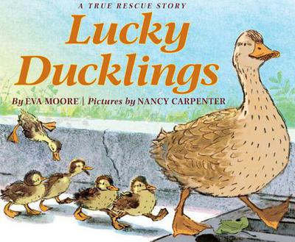
Lucky Ducklings by Eva Moore; Illustrations by Nancy Carpenter
As they wander through town and follow their mother, little ducklings fall between the slats of storm drains and have to rescued by firemen. Based on a true story.

Slide 15
If It's Snowy and You Know It, Clap Your Paws by Kim Norman; Illustrations by Liza Woodruff
This humorous variation on the classic song "If You're Happy and You Know It" introduces a group of adorable animals playing joyfully in the snow. They tumble on the tundra, catch snowflakes on their tongues, sculpt snowanimals, and make a frosty fort.

Slide 16
Clara and Davie by Patricia Polacco
This short biography offers a glimpse into Clara Barton’s childhood. Plagued by a speech impediment, Clara sought refuge outdoors where she cared for animals and relied on her nurturing older brother Davie.

Slide 17
Sky Color by Peter Reynolds
Marisol loves to paint. When her teacher asks her to help make a mural for the school library, she can't wait to begin. How can Marisol make a sky without blue paint?

Slide 18
The Favorite Daughter by Allen Say
Yuriko, teased at school for her unusual name and Japanese ancestry, yearns to be more ordinary until her father reminds her of how special she is.

Slide 19
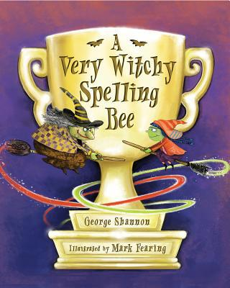
A Very Witchy Spelling Bee by George Shannon; Illustrated by Mark Fearing
Cordelia loves to spell in every way: studying spelling and practicing spells. She especially likes to double spell, turning her C-A-T into a new C-O-A-T by zapping it with the letter O. When she sees a sign for the Witches' Double Spelling Bee, she knows it's meant just for her.

Slide 20
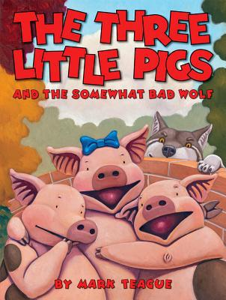
The Three Little Pigs and the Somewhat Bad Wolf by Mark Teague
Three pigs spend their money on different things: potato chips, colas, and building supplies. It comes as no surprise that a wolf is able to blow down the first two pigs' houses. When the wolf can't blow down the third pig's brick house, everyone comes together and the fun begins.

Slide 21
That is Not a Good Idea by Mo Willems
A plump mama goose is invited to dinner by a hungry fox while her gooslings try to warn her that it is a bad idea.

